Slide 2
Transmission media
Located below physical layer and directly controlled by the physical layer
Computers and telecommunication devices use signal to transfer data
which is transmitted in the form of electromagnetic energy with the help of transmission media

Slide 3

Figure 1 Transmission medium and physical layer

Slide 4
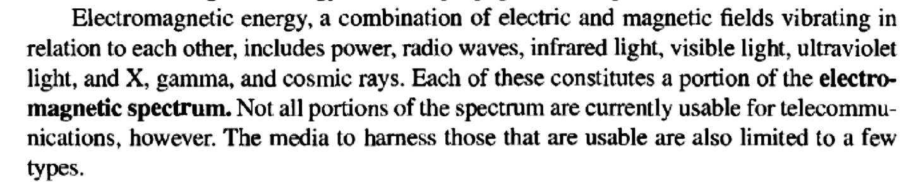

Slide 5

Figure 2 Classes of transmission media

Slide 6
7-1 GUIDED MEDIA
Guided media, which are those that provide a conduit from one device to another, include twisted-pair cable, coaxial cable, and fiber-optic cable.
Topics discussed in this section:
Twisted-Pair Cable : Signal transmitted in the form of electric current
Coaxial Cable: same as TPC
Fiber-Optic Cable: Light

Slide 7
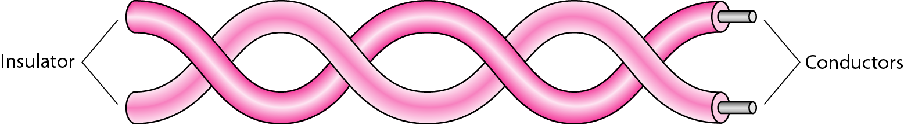
Figure 3 Twisted-pair cable

Slide 8
Twisted-pair cable
Consists of two conductors, each with its own plastic insulation twisted together.
One is used to carry signal other is used as ground reference.
Receiver uses the difference between thr two.
Noise may affect both wires
Number of twists per length has effect on the quality of wire.

Slide 9

Figure 4 Two types: UTP and STP cables
Bulkier and more expensive

Slide 10

Electronic Industries association
Table 7.1 Categories of unshielded twisted-pair cables

Slide 11

Figure 5 UTP connector
RJ: Registered Jack
Keyed connector

Slide 12

Figure 6 UTP performance
Gauge: measure of thickness of wire
Attenuation versus frequency and distance

Slide 13
TP Applications
Used in telephones to provide voice and data channel.
DSL lines: Unshielded twisted pair cables
Local area networks: 10Base-T ,100Base-T

Slide 14
Coaxial cable
Carries signals of higher frequencies as compared to TP cables.
A central core conductor enclosed in a insulating sheath enclosed in a outer conductor of metal foil which is also enclosed in an insulating sheath.

Slide 15

Figure 7 Coaxial cable

Slide 16

RG Rating : Radio Government ratings
Table 7.2 Categories of coaxial cables

Slide 17



Figure 8 BNC connectors three types

Slide 18

Both bandwidth and attenuation is higher
Figure 9 Coaxial cable performance

Slide 19
Coaxial cable applications
Analog telephone networks
Hybrid networks
Traditional ethernet LAN

Slide 20
Fiber optic cable
Made of glass or plastic
Transmits signal in the form of light

Slide 21

Figure 10 Bending of light ray

Slide 22

Figure 11 Optical fiber

Slide 23

Figure 12 Propagation modes along optical channels
Multiple beams from a light source move through the core in different paths
Density of cores remains constant from core to edges
Density of cores highest at the centre and lowest at the edges

Slide 24

Figure 13 Modes

Slide 25

Table 7.3 Fiber types
Defined by ratio of the diameter of their core to the diameter of their cladding

Slide 26

Figure 14 Fiber construction

Slide 27

Figure 15 Fiber-optic cable connectors
Cable TV
Internet devices

Slide 28

Figure 16 Optical fiber performance

Slide 29
Advantages and disadvantages of optical fibre
Higher bandwidth
Less signal attenuation
Immunity to electromagnetic interference
Resistance to corrosive material
Light weight
Greater immunity to tapping
Installation and maintenance
Unidirectional light propagation
cost

Slide 30
7-2 UNGUIDED MEDIA: WIRELESS
Unguided media transport electromagnetic waves without using a physical conductor. This type of communication is often referred to as wireless communication.
Topics discussed in this section:
Radio Waves
Microwaves
Infrared

Slide 31

Figure 17 Electromagnetic spectrum for wireless communication

Slide 32

Figure 18 Propagation methods
Distance depends on amount of power in the signal

Slide 33
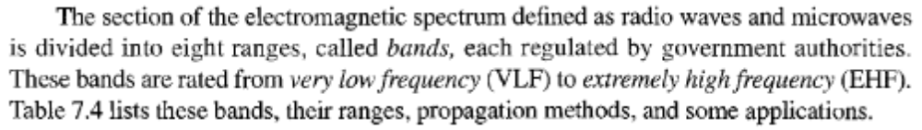
Table 7.4 Bands

Slide 34

Table 7.4 Bands

Slide 35

Figure 19 Wireless transmission waves

Slide 36

electromagnetic waves
Range | Waves | property
 | Radio waves | Omni - directional
 | Micro waves | Uni-directional

Slide 37
Radio waves
Omni directional
Sky mode: travel long distance: AM radio
Low and medium frequency can penetrate walls
Band is relatively narrow leading to low data rate for digital communications
Useful for multicasting applications like paging, radio, television etc.

Slide 38

Figure 20 Omnidirectional antenna

Slide 39
Microwaves
Unidirectional and narrowly focussed
Line-of-sight propagation
Repeaters often needed in long distance communication
Very high frequency microwaves cannot penetrate walls
Higher data rate possible due to wider band

Slide 40

Figure 21 Unidirectional antennas

Slide 41

Note
Microwaves are used for unicast communication such as cellular telephones, satellite networks,
and wireless LANs.

Slide 42

Note
Infrared signals can be used for short-range communication in a closed area using line-of-sight propagation.
Cannot penetrate walls

Slide 43

Reference:Chapter 7
Transmission Media

